Slide 1

Portofolio
Andika Risky Saputra
Moderator

Slide 2
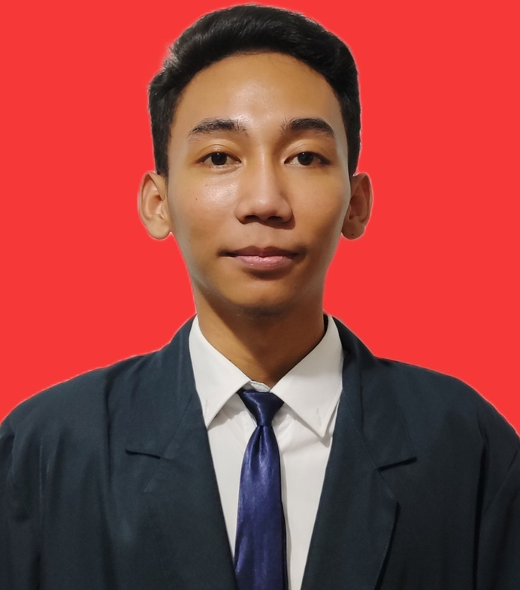

About Me
Graduates of S1 Informatics Engineering at Indraprasta PGRI University.
Have 3 years of work experience in the field of customer service.
I am eager to continue to grow and make a positive contribution in the team and company where I work.

Slide 3


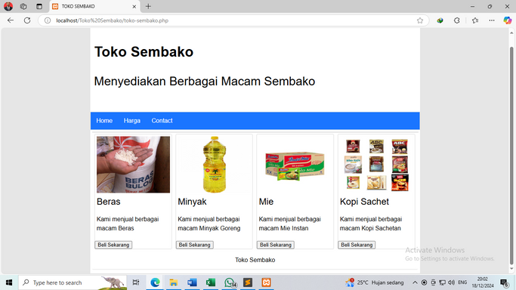
Project
This automatic height measuring device is designed using Arduino Uno and Ultrasonic Sensor.
Automatic Height Gauge
Creating a grocery store website using the PHP programming language
Grocery Store Website

Slide 4
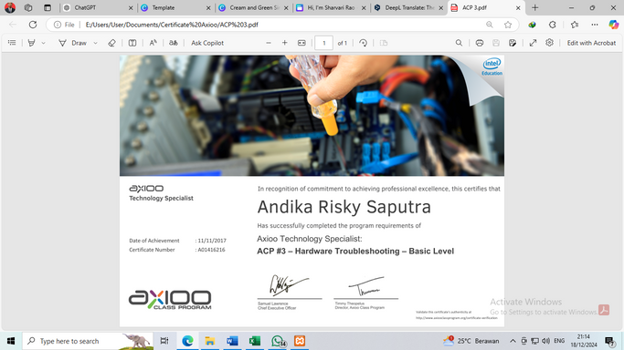
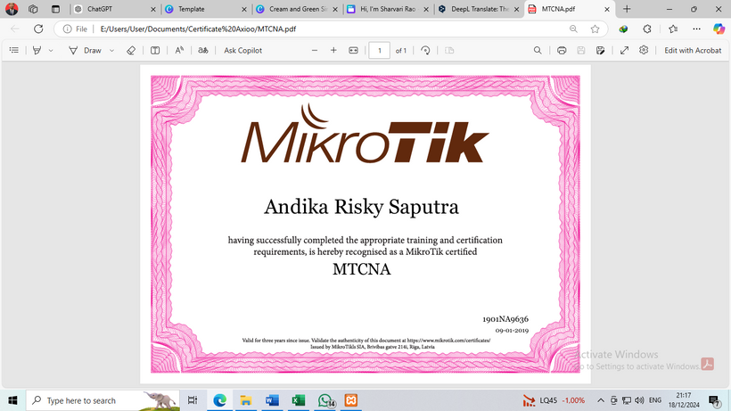
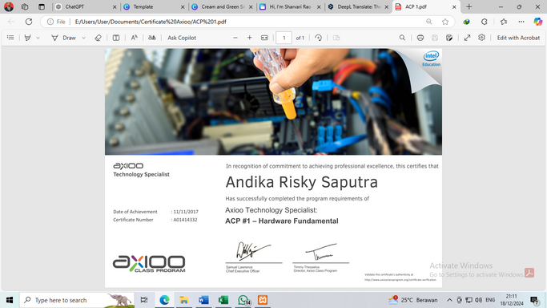








Skills And Certified
ACP #1 – Hardware Fundamental
ACP #3 – Hardware Troubleshooting
Basic Level
MTCNA
Software
Language
Inggris (Basic)
Malaysia (Basic)

Slide 5





Thank You
CONTACT ME
+6289626075179
andikarisky08@gmail.com
www.linkedin.com/in/andika-risky-saputra

